Slide 1


PYTHON
HACKATHON
Aug 2024

Slide 2

HACKATHON TIMELINE
LAUNCH
GIT HUB LINK
SUBMISSION
PRESENTATION
Today!
Aug 15th
Access given:
Launch Folder
Due on 16th August
by 6 PM EST
GIT folder to be shared with:
rkalaichitra@gmail.com
gunjan2986@gmail.com
Due on 22nd August
by 6 PM EST
Documents:
Main Jupyter Notebook with 80 questions
Additional analysis in separate Jupyter notebook.
DA session at 9.30 PM EST

Slide 3

KEY HIGHLIGHTS
01
05
80
Week
Team Members
Questions
Each team of 4-5 has 1 week to complete all 80 questions. At-least 60 questions must be completed to be eligible for evaluation.
Additional questions must uncover additional analysis which is not already present in the main 80 questions.
Each team has 4 minutes to present & can use upto a maximum of 6 slides in their presentation. All team members must present.
The presentation must include one technical challenge you faced & an explanation of how you overcame it.

Slide 4

Naming Conventions
01
Folder & GIT
TeamNumber_TeamName_PythonHackathon_Aug24
02
TeamNumber_TeamName_Main80Questions.ipynb
TeamNumber_TeamName_AddnlQuestions.ipynb
Main 80 & Additional Questions
03
Presentation PPT
TeamNumber_TeamName_PPT

Slide 5
SCORE BREAKDOWN
TOTAL SCORE | 1100
Score for attempting all of the 80 questions | 200
Max score for getting 80 questions right | 300
Max score for optimization | 100
Max score for utilizing Github well | 100
Max score for additional analysis | 200
Max score for submission, documentation, and presentation | 200

Slide 6
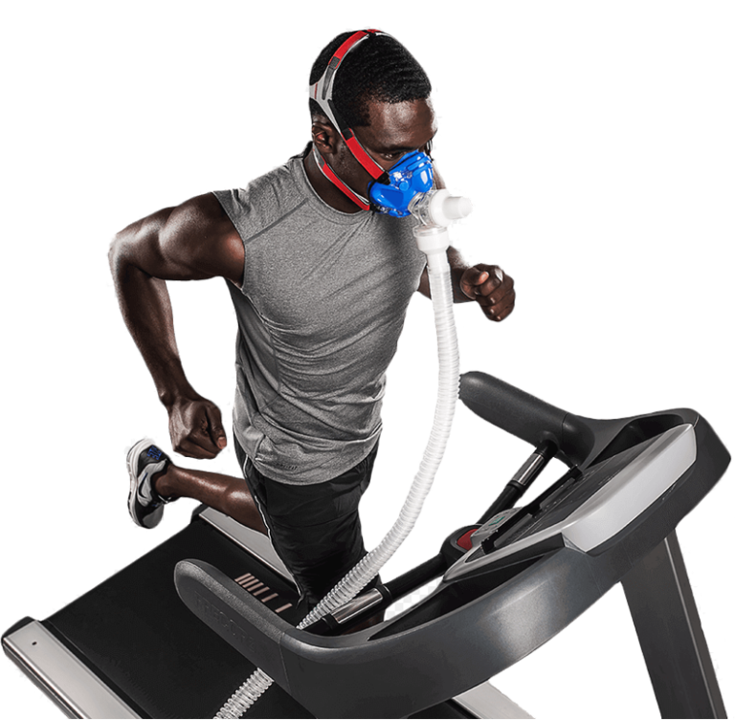
THE DATASET (V02Max_Combined.xlsx)
The Graded Exercise Testing (GET) is a crucial tool for evaluating athletes' global fitness in a sports context.
This dataset was used in a research study on heart rate variability during exercise, with the R code for the study available in a public repository for reproducibility.
The dataset has potential for supporting further research on heart rate variability, particularly in athletes undergoing graded exercise testing.
Users should note that the subjects in this study are athletes from various sports disciplines (kayak, triathlon, and fencing) and are exposed to a tropical climate (French West Indies).
Access to the dataset at PhysioNet ACTES Cycloergometer Exercise.

Slide 7

Embrace the challenge, Code with Python and take a step towards transforming data into Innovation.
- Taylor Quinn

Slide 8
THE ORGANIZING TEAM
Krishna
Jyotsna
Sushma
Reena
Uma
Gunjan
Renuka
Sudha
Divya
Kalaichitra

